Slide 1
Capstone meeting 07 Oct 2024
Client: Springboard Clinic
Advisor: Vincent Cheung
Team 4 – Data Analytics, Langara College

Slide 2
Meeting agenda
Status Updates
Current Challenges
Proposal
Next Steps & Action Items

Slide 3
Objective
Objective: Dashboard visualization for performance and incentive evaluation
Expected output
Input data
Must have: color-coding
FT and Contractor

Slide 4
Project criteria
Robust and immaculate accuracy (must be able to validate)**
Open-sourced tools
User-friendly
Scalable
Notes:
Decision-making

Slide 5
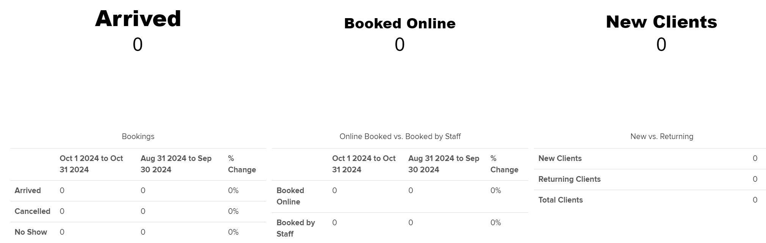
Jane Dashboard

Slide 6
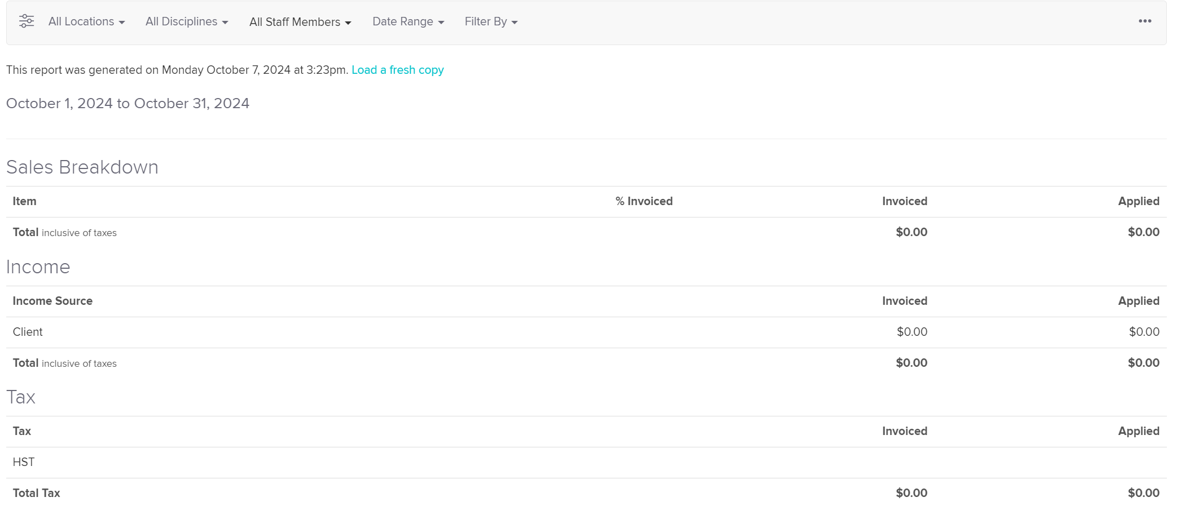
Jane Summary Sales report

Slide 7
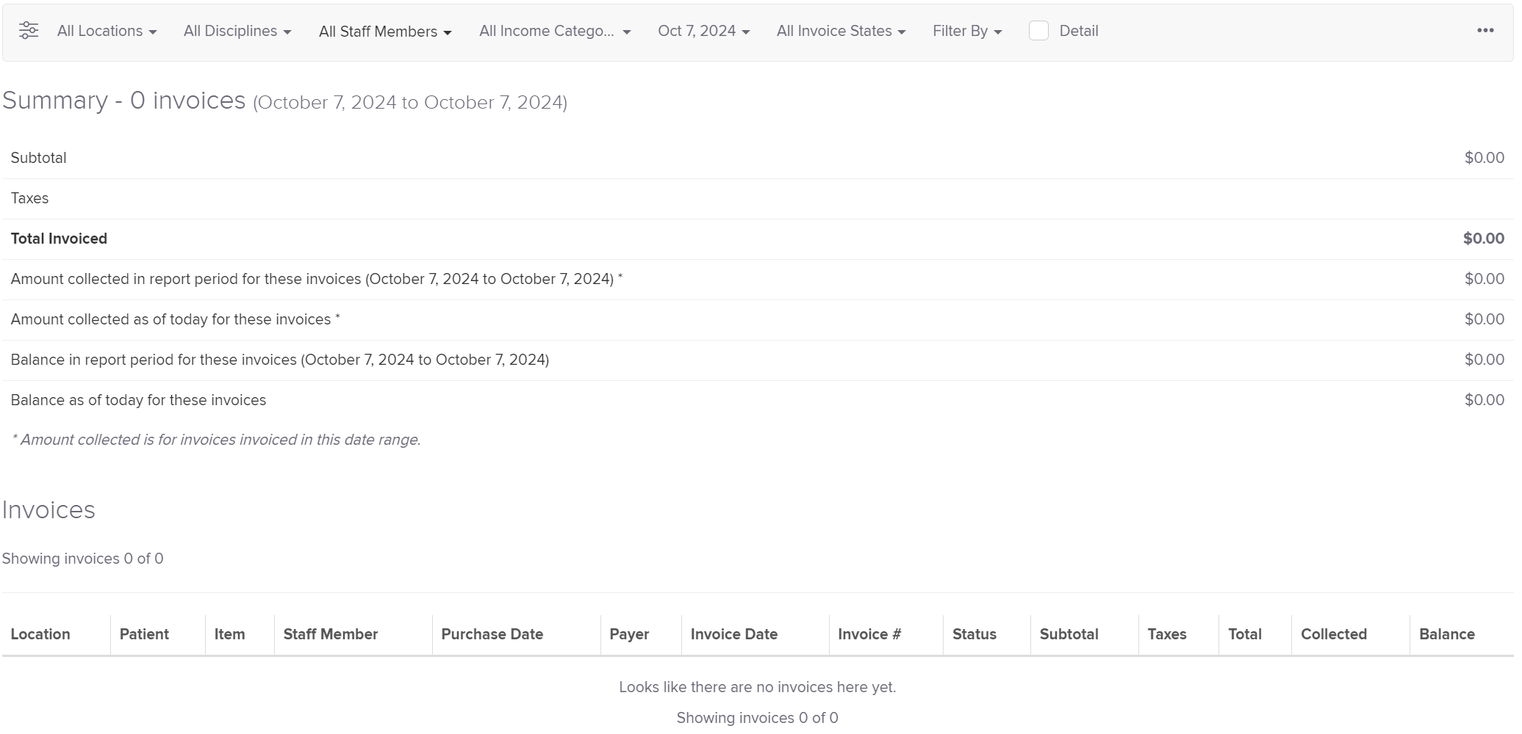
Jane Sales report is the closest format to current practice
Does it contain the key multiplier?

Slide 8
Current challenges
No sample data, no report from Jane
Unknown data input process
IT support
Accuracy validation

Slide 9
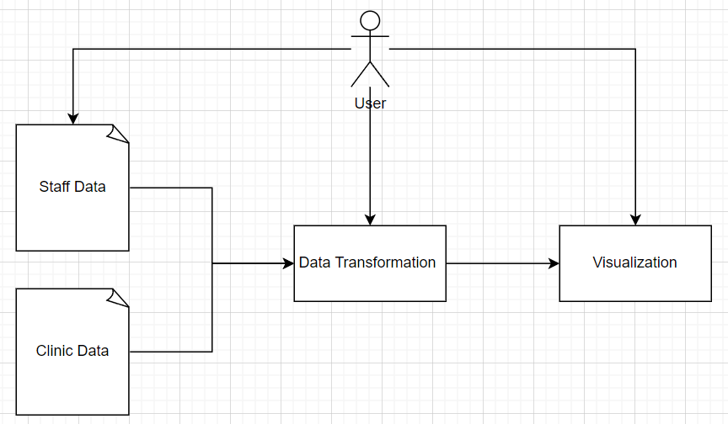
Current workflow
This project consists of 3 main tasks: Extract data -> Store the data (local) -> Transform the data into dashboard

Slide 10
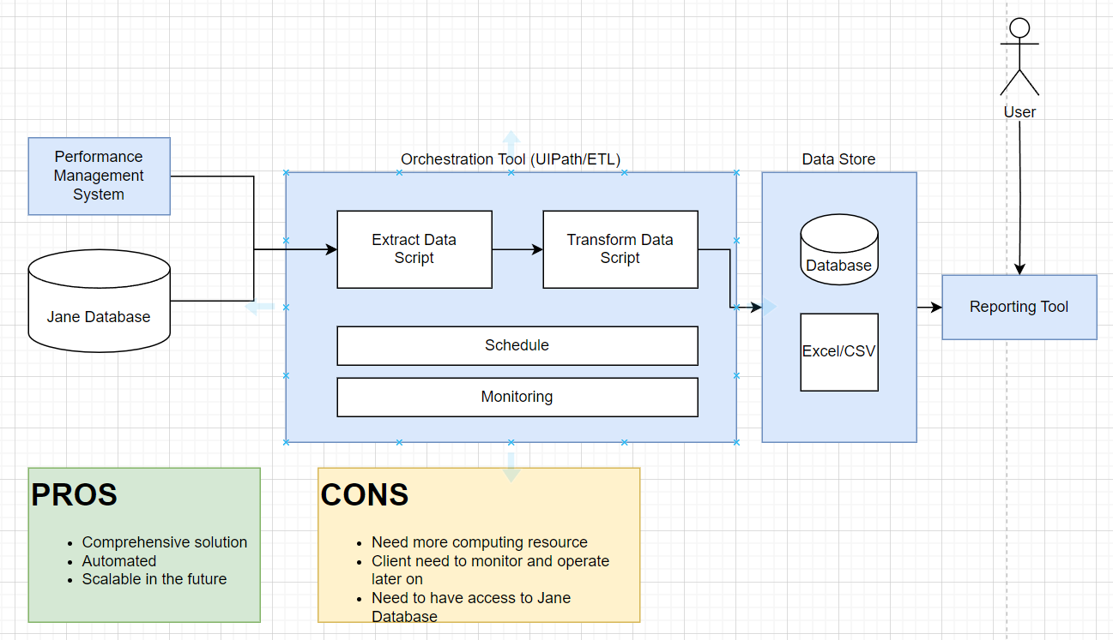
Option 1: fully automated

Slide 11
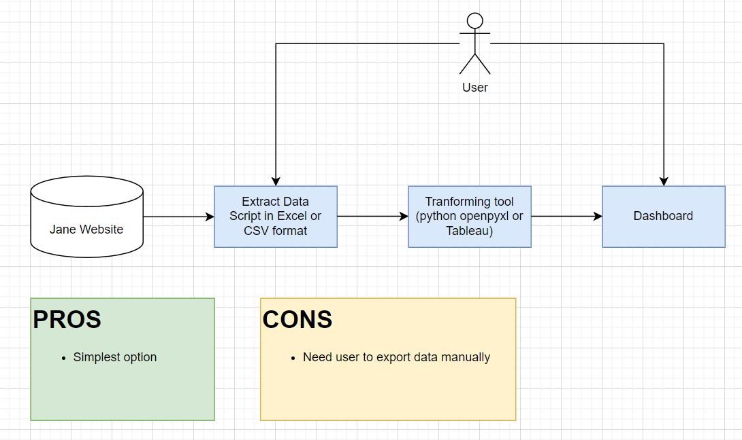
Option 2: partial data transformation

Slide 12
Next Steps & Action Items
Assign follow-up actions or tasks
Set deadlines for proposal decisions or next step

